Slide 1
FEMA and GPD’s
Environmental Planning & Historic Preservation Review
Ellen Saint Onge
GPD EHP Branch Chief
Ellen.saint-onge@fema.dhs.gov
Elizabeth McWaters-Bjorkman
GPD Environmental Protection Specialist
Elizabeth.mcwaters-Bjorkman@fema.dhs.gov
EMI
Feb 2018

Slide 2

Environmental Planning & Historic Preservation (EHP)
Why we do EHP:
What is an EHP Review?
Why do EHP?
Benefits vs. Consequences
How we do EHP:
What We Need to Know
What We’d Like to Know
EHP Process, Timelines, & Additional Consultation
Online Resources and Contacts

Slide 3
What Is an EHP Review?
  Analysis of pertinent project information to determine compliance with environmental laws, regulations, and executive orders:
  All projects funded with federal grant dollars must comply with EHP laws, regulations, and Executive Orders
  EHP review must be completed by FEMA/GPD before project initiation
  Recipients must provide all required EHP information to GPD via the GPD EHP Inbox at GPDEHPinfo@fema.dhs.gov

Slide 4
National Environmental Policy Act
Public Law 91-190
Congressional mandate that before federal agencies make decisions, they must consider the effects of their actions on the quality of the human environment
Human environment is broadly defined
NEPA analysis is scaled to project
Notes:
Broadly defined – not just animals, but impact on other people, noise, socioeconomic impacts
Scaled to size, bigger projects may require public input to identify the specific environmental issues to that area
Would include analysis of direct effects, indirect effects, and cumulative effects

Slide 5
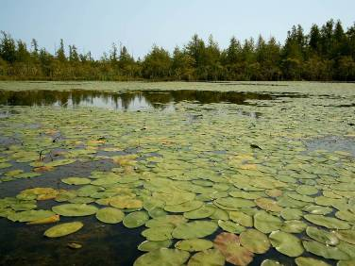
What Are EHP Considerations?
  Cultural Resources
    Historic properties
    Archaeological sites
  Floodplains
  Wetlands
  Endangered Species
  (including habitat)
  Coastal Zones
  Water Quality
  Air and Noise
  Vegetation and Wildlife
  Environmental Justice
  Socioeconomic Resources
  Land Use and Agriculture
  Hazardous Materials
  Traffic
  Geology (topography, soils)
5
Notes:
Human Environment is broadly defined

Slide 6
EHP Laws and Executive Orders: Basis for FEMA EHP Review
Endangered Species Act
Executive Orders:
National Historic
Environmental Justice
Preservation Act
Seismic Retrofit
Floodplains
Wetlands
NEPA
Clean Air Act
Coastal Barrier
Clean Water Act
Resources Act
Resource Conservation &
Coastal Zone
Recovery Act
Management Act

Slide 7
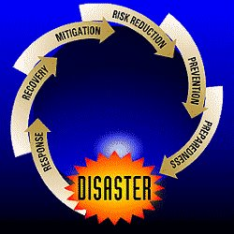
FEMA and GPD’s EHP Review
EHP compliance for GPD-funded projects is GPD’s responsibility, in collaboration with:
FEMA’s Office of Environmental Planning and Historic Preservation (OEHP)
FEMA’s Regional Environmental Offices
Notes:
Add references to updated policy here? Mention directives?

Slide 8


FEMA’s EHP Review
May require consultation with other federal agencies, including informal consultation, formal consultation, or agreement documents.
  State Historic Preservation Office
  Tribal Governments
  US Fish and Wildlife Service
  US Army Corps of Engineers

Slide 9
FEMA’s EHP Review
NEPA environmental review process may result in:
  Categorical Exclusion (CATEX)
  Environmental Assessment (EA)
  Environmental Impact Statement (EIS)
NEPA, and other EHP laws and EOs may require public involvement & a public comment period depending on scope and impacts of project.
Notes:
Most of GPD projects are categorical exclusions.

Slide 10


Projects that do not Trigger EHP Review
- Planning Documents
- Management and Administration
- Classroom-based Training/Table-top Exercises

Slide 11
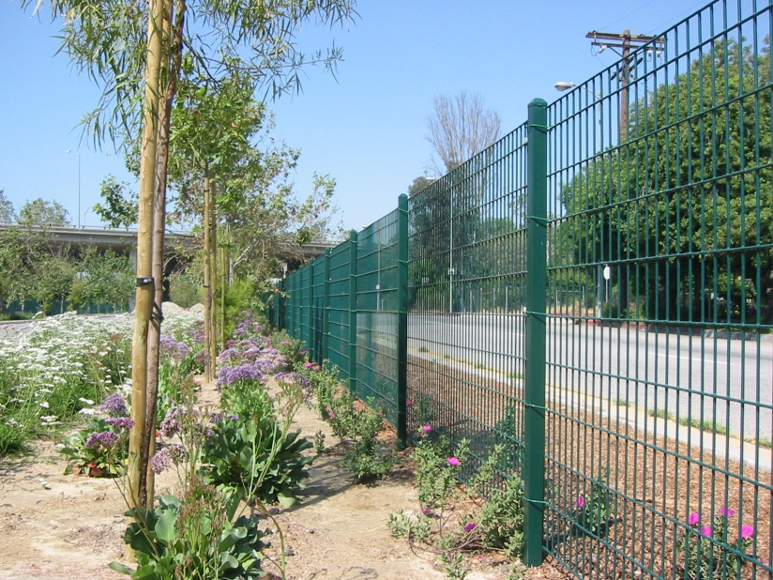
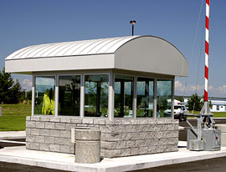

Projects that Trigger EHP Review
- Facility construction
- Modification/renovation of existing structures
- Physical security enhancements to buildings or structures
- Construction or modification of Communication towers
- All ground disturbances

Slide 12
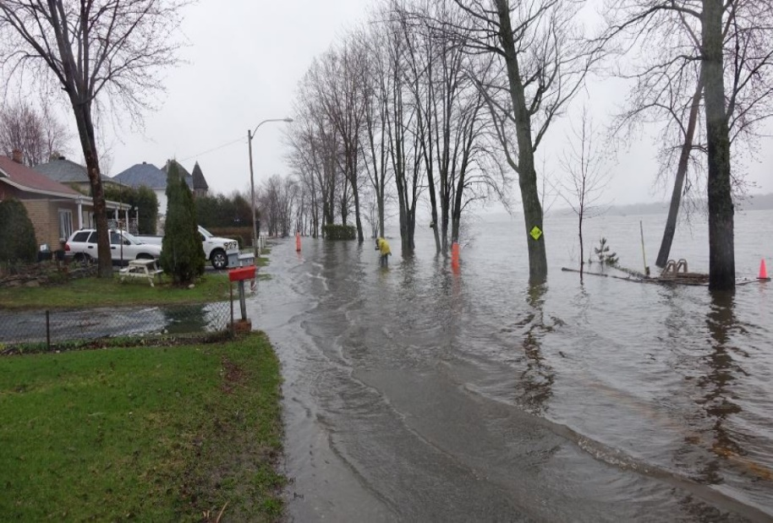
EHP Review
Benefits
Informed decision-making
Ensure compliance
Protect community and investments
Minimize or avoid potential adverse effects to communities and individuals
Protect our nation’s water, air, coastal, fish and wildlife, agricultural, historical, and cultural resources

Slide 13
Consequences of
Non-Compliance
Denial of funding
Project delays
Negative publicity
Civil penalties
Lawsuits

Slide 14
GPD EHP Review
    FEMA’s EHP Review is required by Federal laws, regulations and Executive Orders.
    Must be complete before FEMA can fund any project.
    Purpose of EHP Review is to ensure compliance - not to deny projects. Sometimes projects may need to be modified to minimize impacts.

Slide 15

GPD EHP Review
  Costs of environmental review (e.g., archeological surveys, reports) are paid by recipient, and can be part of grant expenditures.
  Recipients must provide all required EHP materials to GPD via the GPD EHP Inbox at GPDEHPinfo@fema.dhs.gov.

Slide 16
WHAT WE NEED TO KNOW
H
Help us help you

Slide 17
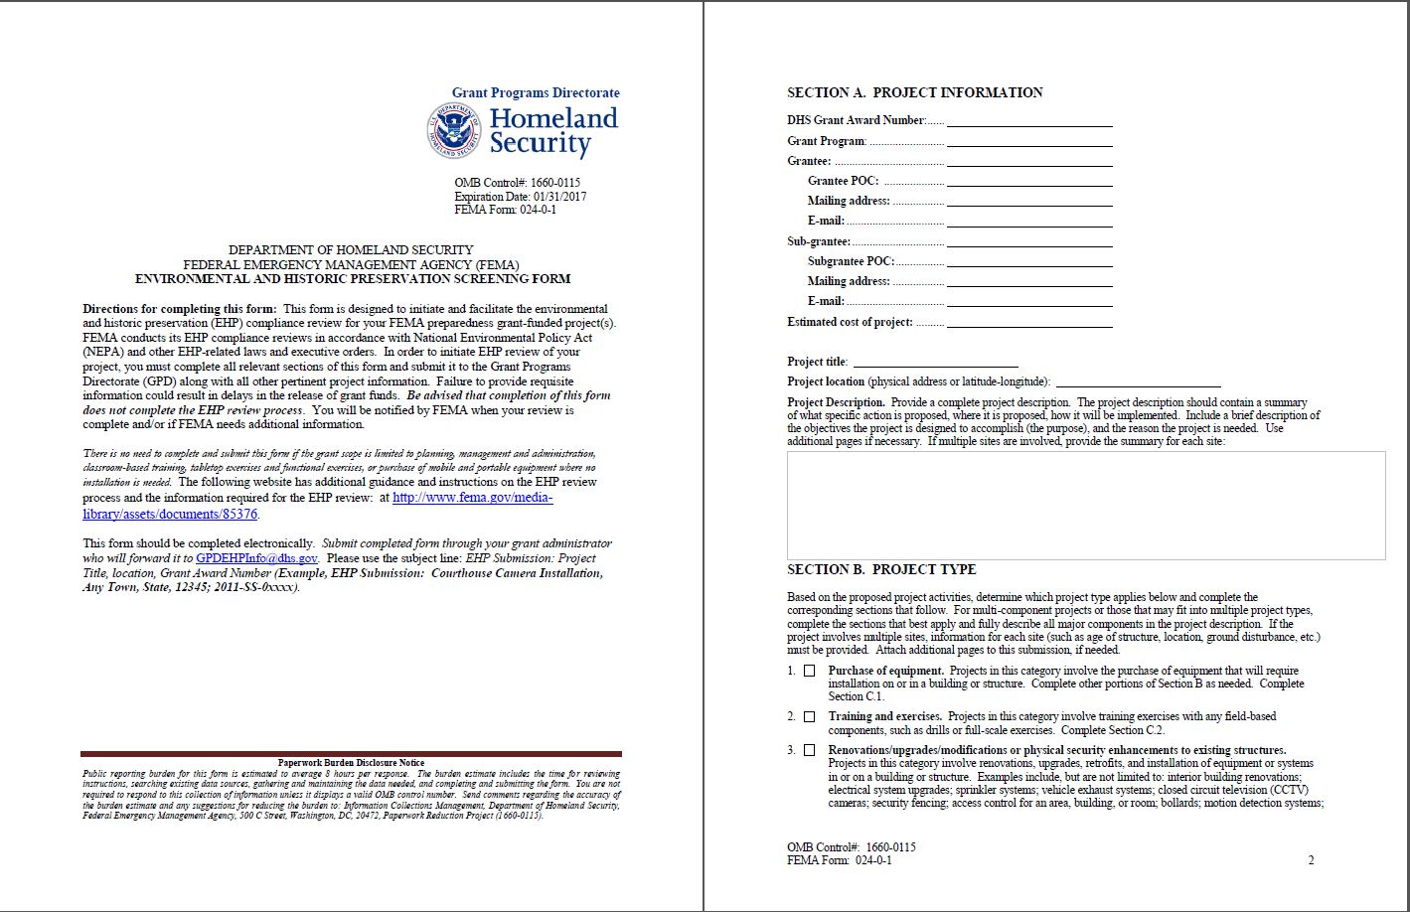

Slide 18
1. Scope of work (complete and accurate)
Bad
Install cameras in courthouse
Good
Install 4 Panasonic VT-5 video cameras on first floor of 1898 county courthouse. Cameras will be installed opposite exit doors, 2 feet below drop ceiling (see diagram for location, position, and height). Wiring will use existing conduits… etc.

Slide 19
1. Scope of work (continued)
Bad
Build EOC
Good
Build 4 story, 6000 sq ft EOC on vacant lot, last used for farming. Slab on grade construction with 4 ft footers. See site plan. Site will be graded and an estimated two feet of soil removed. Utilities will be installed 2 feet below grade… etc.

Slide 20
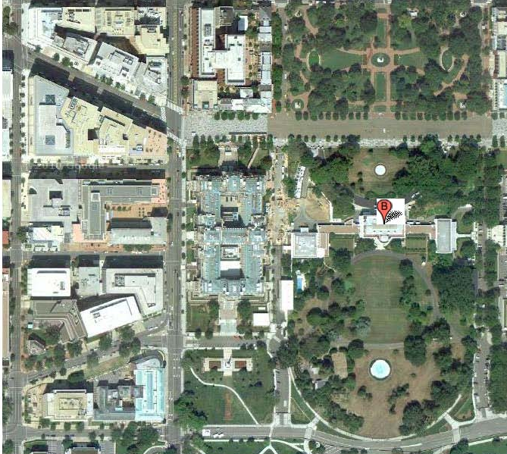
2. Location and Aerial Photo
Address
Latitude / Longitude
Aerial photo with location marked
Example
1600 Pennsylvania Ave NW, Washington, DC 20500
N 38.89770, W 77.03652

Slide 21
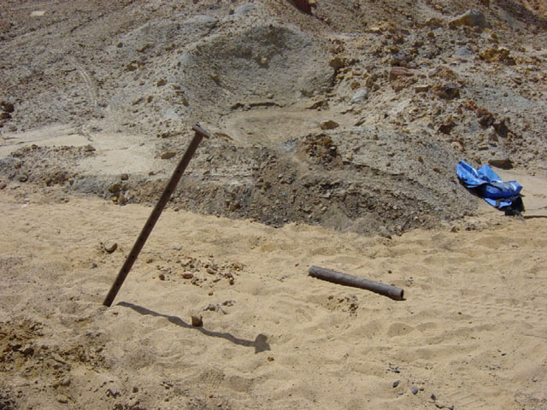
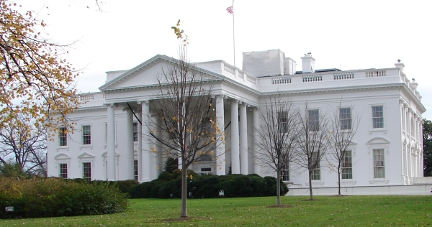

3. Ground Level Photographs (with captions)
Bad
Good
North face
South face

Slide 22
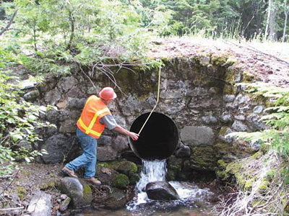
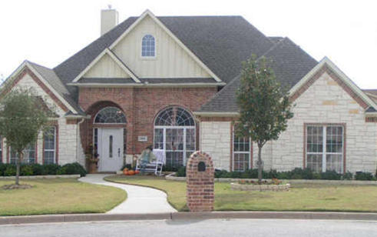
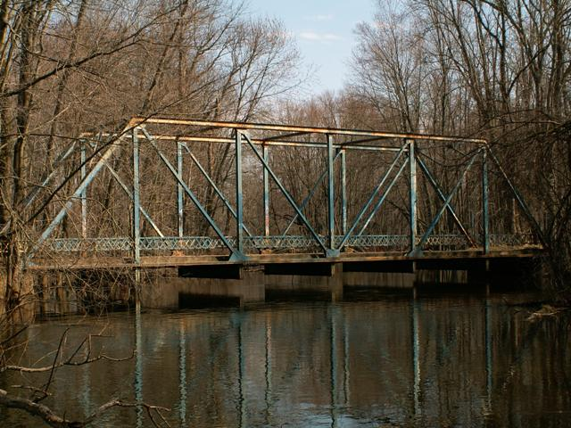
4. Year built (man-made)
Example 1
Construction began 1792, completed 1800
Rebuilt 1817, additions in 1824, 1829, 1901
Interior structural renovations 1927, 1946, 1948
Example 2
Built 2005

Slide 23

5. Ground disturbance
Grading, removing, or digging into soil
Adding soil to site
If adding soil, where did the soil come from? e.g., commercial source, borrow pit, etc.
Example: length, width, and depth of trenching for conduit

Slide 24
WHAT WE’D like TO KNOW
H
Help expedite the review

Slide 25
Complete information
Complete the screening form
Ensure project location, construction date of building, description of any ground disturbances (L x W x Depth).
Good photos: indicating where items will be installed, where ground disturbances will occur.
Provide any other Agency consultation documents

Slide 26
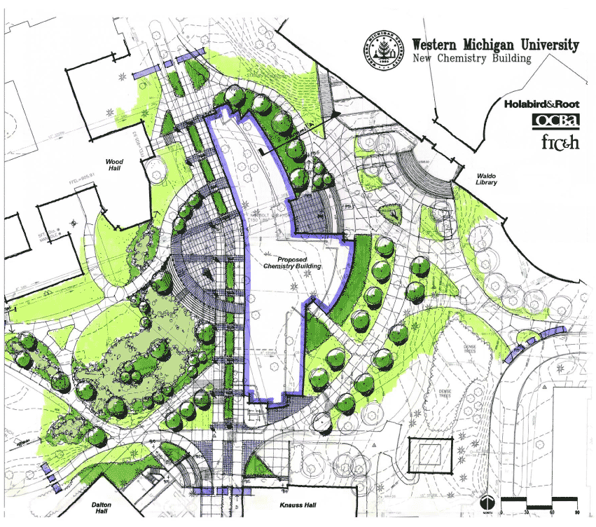

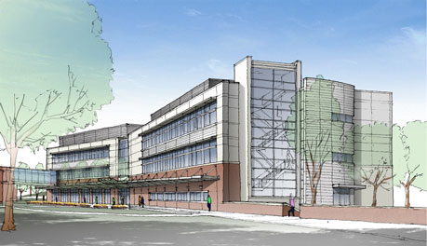
Plans, drawings, blueprints
West face
East face

Slide 27
Process, Timelines,
& Extenuating Circumstances

Slide 28
What to Expect with a GPD EHP Review
  Complete and submit EHP Screening Form and information to GPD EHP (send to GPDEHPinfo@fema.dhs.gov)
  Recipient will receive receipt confirmation email within 48 hours indicating when the review will start
  Recipient will receive an EHP tracking ID number

Slide 29
What to Expect with a GPD EHP Review (Continued)
  GPD EHP reviews EHP packet. Notifies recipient if additional information is needed
  GPD EHP completes initial compliance review and makes a determination within 30 days of initial receipt.
  The outcome will be that the EHP Review is complete, or that it is being sent to a Regional Environmental Office for further review
  PA notified of GPD EHP review results

Slide 30
Common Reasons for EHP Delays
  Incomplete information: request for more information = project delays
  Poor or absent ground-level photographs
  Inadequate project description
  Poor or absent aerial photographs
  Extent of ground disturbance unclear or not included
  No project location (physical addresses or latitude-longitude)

Slide 31
Extenuating Circumstances
Section 106 (NHPA) consultation required (SHPO or Tribal response to request for consultation within 30 days, for complex projects consultation may take longer)
ESA formal consultation required (may take up to 135 days)
Environmental assessment is required
Memorandum of agreement is required

Slide 32
Online Resources
  GPD EHP Information on-line – screening form, instructions, policy guidance, etc…
  http://www.fema.gov/environmental-planning-and-historic-preservation-compliance

Slide 33
Contact Us
GPDEHPinfo@fema.dhs.gov

Slide 34


